Slide 1
Modelling the interplay of metaphor and emotion through multitask learning
verna dankerrs, marek red, martha lewis, ekaterrina shutova
Presented by,
Madhuri sarda
Poonam Kankariya
Rohita goparaju

Slide 2
paper Abstract
Use of Strom @ Twitter
with future potential

Slide 3
introduction
Need of the hour: real-time data management system
Fuel

Slide 4
Related work
Computational models of metaphor
Computational models of emotion
Metaphor and emotion

Slide 5
Tasks and datasets
VUA Metaphor Corpus
LCC Metaphor Corpus
EmoBank Corrpus

Slide 6
VUA metaphor corpus
Subset of British National Corpus
Word annotated
Literally
Metaphorically-used
Over ten thousand sentences sampled from four genres – Academic Writing, News, Conversation, Fiction
Inter-annotator agreement = 0.84 (Fleiss’s

Slide 7
lcc metaphor corpus
EmoBank Corrpus

Slide 8
Emobank corpus
Add content herre

Slide 9
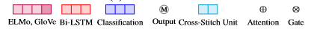
Methods of approach
Hard Parameter Sharing
Cross-stitch Network
Gated Network

Slide 10
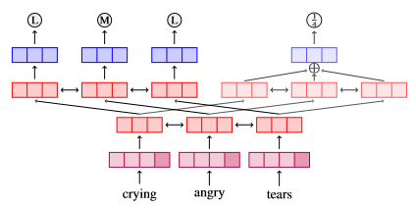
Method – hard parameter sharing
Add content here

Slide 11
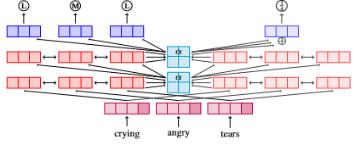
Method – cross-stitch network
Add content here

Slide 12
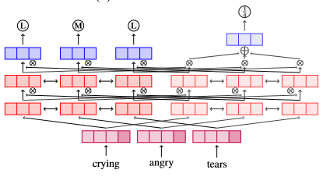
Method – gated network
Add content here

Slide 13
experiment
Add content here

Slide 14
Results
Add content here

Slide 15
Data analysis & discussion
Metaphor Identification
Emotion Prediction

Slide 16
conclusion
Add content here

Slide 17
Data model components
Tuple
An unordered list of named fields of dynamic type
Default serialization of primitive data of strings and byte arrays eliminating the need to declare the data type
Stream
An unbounded sequence of tuples
Enables parallel processing of multiple streams

Slide 18
Data process Architecture
Stream of tuples flowing through topologies
Topology
Directed graph containing vertices representing computations and edges representing data flow between components of comnputation
Vertices consists of disjoint sets of types
Spouts – tuple sources of topology
Bolts – process incoming tuples and pass them to appropriate bolts downstream

Slide 19
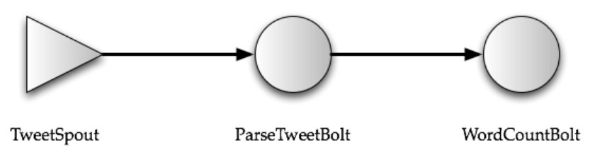
Tweet word count topology

Slide 20
Basic concepts
Storm runs on a distributed cluster
Like Mesos at Twitter
The master node -- Nimbus
Client submit topologies
Distributing and coordinating the execution of the topology
The worker nodes
Each worker node runs one or more worker processes
Each worker process is mapped to a single topology
More than one worker process on the same machine may be executing different part in the same topology

Slide 21
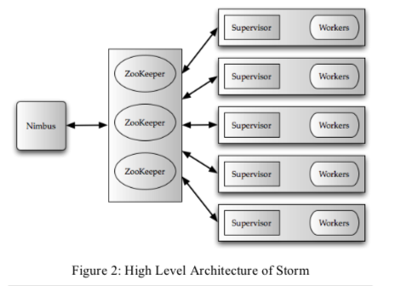
Architecture of the system

Slide 22
Worker processes
Each worker process runs a JVM
It runs one or more executors.
Executors are made of one or more tasks.
The actual work for a bolt or a spout is done in the task
Tasks provide intra-blot/intra-spout parallelism
The executors provide intra-topology parallelism
Worker processes serve as containers on the host machines to run Storm topologies

Slide 23
tasks
Running in a set of executors across machines in a cluster
Associate with each spout or bolt
Data is shuffled from a producer spout/bolt to a consumer bolt
Producer and consumer may have multiple tasks
Shuffling
Exchange operator in parallel databases

Slide 24
Partitioning strategies
NAME | DESCRIPTION
Shuffle grouping | Randomly partitions the tuples
Fields grouping | Hashes on a subset of the tuple attributes/fields
All grouping | Replicates the entire stream to all the consumer tasks
Global grouping | Sends the entire stream to a single bolt
Local grouping | Sends tuples to the consumer bolts in the same executor
Extensible
A topology can define and use its own partitioning strategy

Slide 25
Worker nodes
Each worker node runs a Supervisor
Communicate with Nimbus
Nimbus is responsible for scheduling the topologies on the worker nodes
Monitoring the progress of the tuples flowing through the topology
The cluster state is maintained in Zookeeper
The topology can be considered as a logical query plan from a database system perspective.
The programmer specifies how many instances of each spout and bolt must be spawned.
Part of future work is to automatically pick and dynamically changes this number based on some higher-level objective
Target performance objective
Storm creates these instances and the interconnection for the data flow

Slide 26
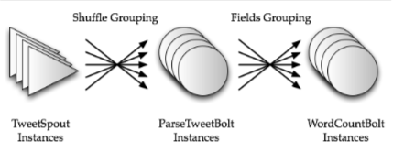
Physical execution of the topology

Slide 27
Storm Internals
Summingbird
Nimbus
Zookeeper
Supervisor

Slide 28

Summingbird
Summingbird is a library that lets you write MapReduce programs that look like native Scala or Java collection transformations
Used for generating Storm topologies
Queries expressed in Summingbird can be automatically translated into Storm topologies

Slide 29
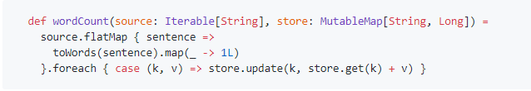
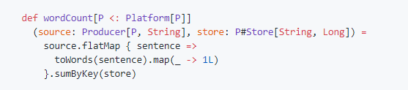
Word count
Word-counting aggregation in pure Scala
Counting words in Summingbird

Slide 30
Summingbird and Hadoop
The logic between Summingbird and MapReduce is exactly the same, and the code is almost the same.
The main difference is that you can execute the Summingbird program in “realtime mode” using Storm.
So we can also use it to generate a MapReduce job to run on Hadoop

Slide 31

nimbus
An open-source toolkit that can provide Infrastructure-as-a-Service (IaaS)
Responsible for distributing and coordinating the execution of the topology
Similar to JobTracker within MapReduce

Slide 32
Nimbus vs jobtracker
Jobtracker
nimbus
Assign MapReduce tasks to specific modes in the cluster
Client applications submit jobs to JobTracker
Locates TaskTracker nodes with available slots and submits the work to the chosen TaskTracker nodes
Used to submit a job to the Storm cluster
User describes the topology as a thrift object and sends that object to Nimbus
Keeps track of topologies that need assignment, and does match-making between pending topologies and the supervisors

Slide 33
Nimbus vs jobtracker
JobTracker is a point of failure for the Hadoop MapReduce service
If it goes down, all running jobs are halted
If Nimbus is down, then users cannot submit new topologies, but the workers still continue to make forward progress

Slide 34

zookeeper
A distributed coordination service for distributed applications
All coordination between Nimbus and the supervisors is done using Zookeeper
Nimbus uses a combination of the local disk(s) and Zookeeper to store state about the topology
User code is stored on the local disk(s) of Nimbus machine, and the topology thrift objects are stored in Zookeeper

Slide 35
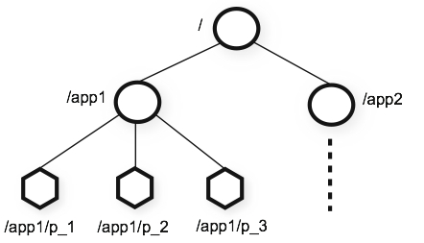
zookeeper
The name space provided by Zookeeper is much like that of a standard file system

Slide 36
Supervisor vs tasktracker
Tasktracker
supervisor
Is a node in the cluster
Accepts tasks - map, reduce and shuffle operations from a JobTracker
Also sends out heartbeat messages to JobTracker
Runs on each node in Storm
Receives assignments from Nimbus and pawns workers based on the assignment
Also sends heartbeat and other monitors of health of the workers

Slide 37
heartbeat
15 seconds
Main thread
Informs Nimbus that supervisor is alive

Slide 38
Synchronize supervisor
10 seconds
Event manage thread
Manages the change of existing assignment, adds new topology, download library and makes synchronize process event

Slide 39
Synchronize process
3 seconds
Process event manager thread
Manages the worker process and reads worker heartbeat
Valid: running
Timed out: dead
Not started: moved or belong to a new topology
Disallowed: killed or moved

Slide 40
Entities to run topology in a storm cluster
Worker Processes
These are independent JVM processes running on a node. Each node is configured to run one or more workers. A topology may request one or more workers to be assigned to it.
Executors (threads)
These are Java threads running within a worker JVM process. Multiple tasks can be assigned to a single executor. Unless explicitly overridden, storm will assign one task for each executor.
Tasks
These are instances of spouts and bolts whose nexttuple() and execute() methods are called by executor threads.

Slide 41
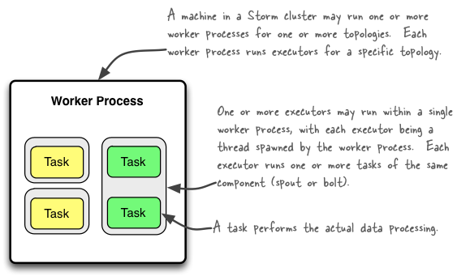
relationship of worker process and tasks

Slide 42
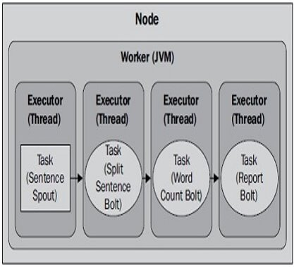
Parallelism in storm
Let’s take word count topology as example. Storm will default most parallelism settings to a factor of one. Assuming we have one machine (node), have assigned one worker to the topology, and allowed Storm to one task per executor, our topology execution would look as:
The only parallelism here we have is at the thread level. Each task runs on a separate thread within a single JVM.

Slide 43
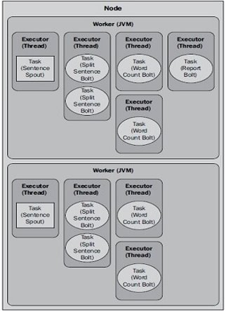
Parallelism in storm
With two workers, the execution of the topology will now look like the adjacent diagram​
With the topology parallelism increased, running the updated WordCountTopology class should yield higher total counts for each word. Since spout emits data indefinitely and only stops when the topology is killed, the actual counts will vary depending on the speed of your computer and what other processes are running on it, but you should see an overall increase in the number of words emitted and processed.​
It's important to point out that increasing the number of workers has no effect when running a topology in local mode. A topology running in local mode always runs in a single JVM process, so only task and executor parallelism settings have any effect.​

Slide 44
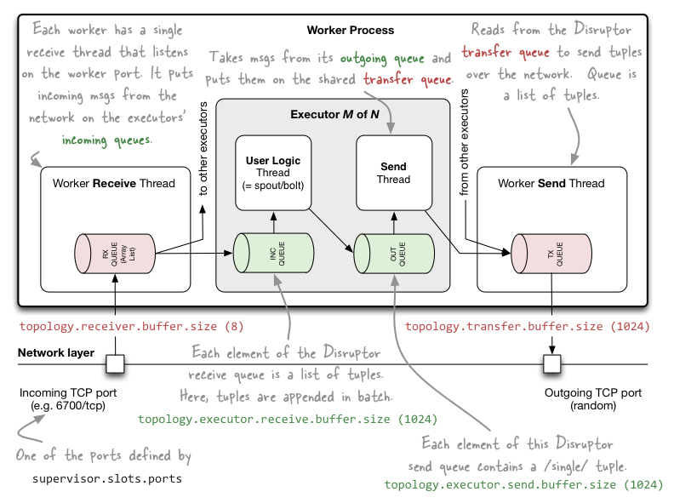
Internal messaging within storm workers processes

Slide 45
Processing semantics
Key characteristic of Storm is
Ability to provide guarantee about the data that it processes
Two types of semantic guarantees provided
“At least once” semantics guarantees that each tuple that is input to the topology will be processed at least once
“At most once” semantics guarantees that each tuple is either processed once or dropped in the case of failure

Slide 46
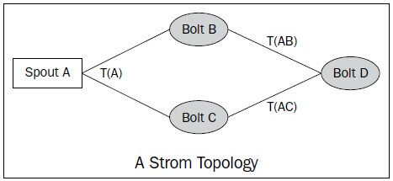
Guaranteeing message processing
Storm guarantees that each message coming off a spout will be fully processed
A tuple coming off a spout can trigger thousands of tuples to be created based on it.
Example: Spout A emits a tuple T(A), which is processed by bolt B, and bolt C which emits the tuples T(AB) and T(AC), respectively. So, when all the tuples produced due to tuple T(A)—namely the tuple tree T(A), T(AB), and T(AC)—are processed, we say that the tuple has been processed completely.
When some of the tuples in a tuple tree fail to process, either due to a runtime error or a timeout, which is configurable for each topology, then Storm considers this to be a failed tuple.

Slide 47
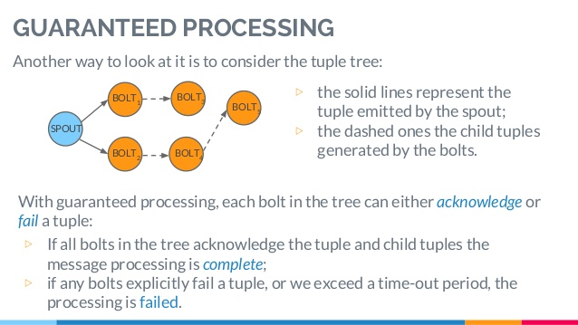
Guaranteed Processing

Slide 48

Storm in use @ twitter
Storm runs on hundreds of servers at Twitter
Several hundreds of topologies run on these clusters some of which run on more than a few hundred nodes
Many terabytes of data flows through the Storm clusters every day, generating several billions of output tuples
Storm is resilient to failures, and continues to work even when Nimbus is down
Latency for processing a tuple is close to 1ms
Cluster availability is 99.9% over the last 6 months

Slide 49
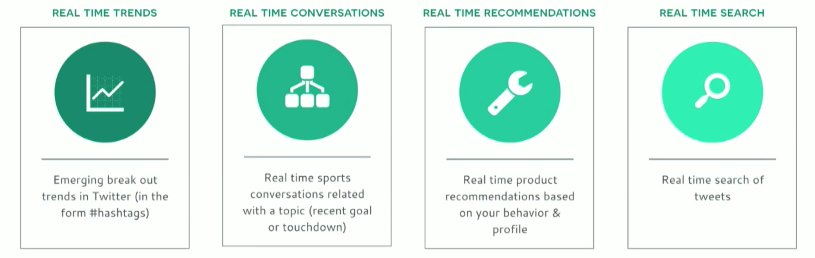
Twitter in real-time
Analyzing billions of events in real time is a challenge

Slide 50

Collecting topology metrics
Metrics Bolt
SCRIBE
Tweet Spout
Parse Tweet Bolt
Word Count Bolt

Slide 51
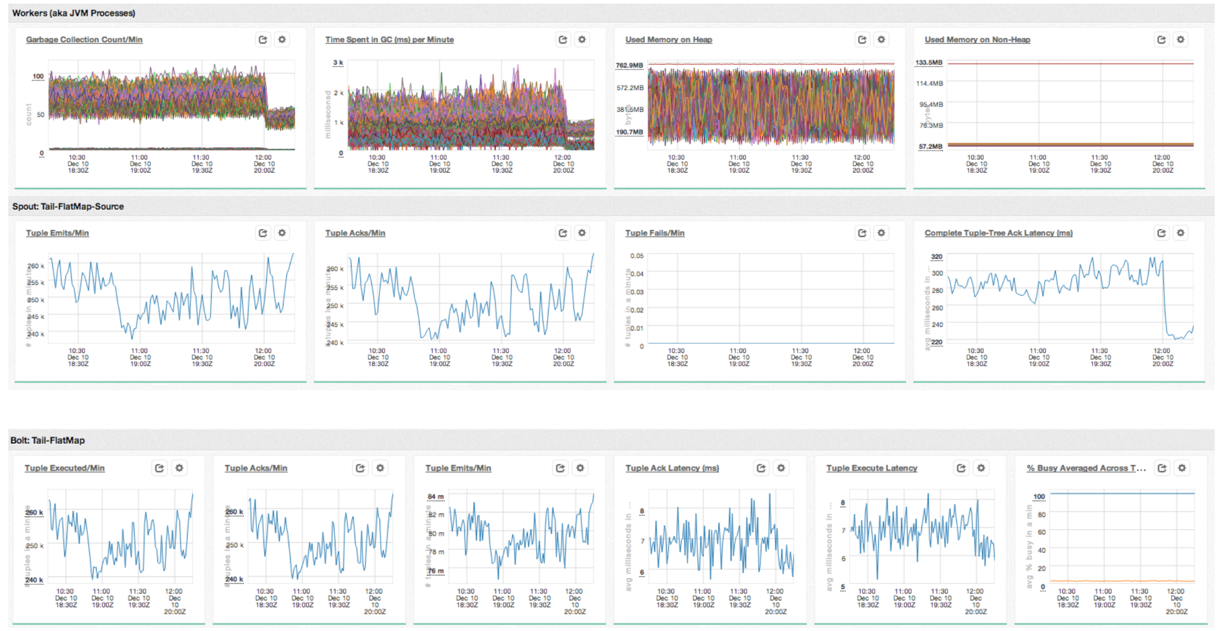
Sample topology dashboard

Slide 52
Operational experiences
Overload Zookeeper – shared configuration
Storm
S1
W
ZK
S2
W
W
S3
Quickly exceeded number of clients
Impacted uptime of other systems

Slide 53
Operational experiences
Overload Zookeeper – detached configuration
Storm
S1
W
ZK
W
S2
ZK
W
S3
Increased to 300 workers per cluster
> 300 – workers get killed and relaunched
Worker heart beats written to zk node every 15 seconds

Slide 54
Operational experiences
Overload Zookeeper – scaled up
Storm
S1
W
ZK
W
S2
ZK
W
S3
Increased to 1200 workers per cluster

Slide 55
Overloaded zookeeper
Analyzing Zookeeper’s traffic
67%
KAFKA SPOUT
Offset/partition is written every 2 seconds
33%
STORM RUNTIME
Workers write heart beats every 3 seconds

Slide 56
Operational experiences
Overload Zookeeper – heart beat daemons
Storm
H
H
S1
W
H
ZK
W
S2
ZK
W
S3
KV
KV
KV
5000 workers per cluster and still growing

Slide 57
Storm overhead
Worker failures and queue backups
JAVA PROGRAM
Read from Kafka cluster and deserialize in a “for loop”
Sustain input rate of 300K messages/sec from Kafka topic
1-STAGE TOPOLOGY
No acks to achieve at most once semantics
Storm processes were co-located using isolation scheduler
1-STAGE TOPOLOGY WITH ACKS
Enable acks for at least once semantics
Exp1
Exp1
Exp1

Slide 58
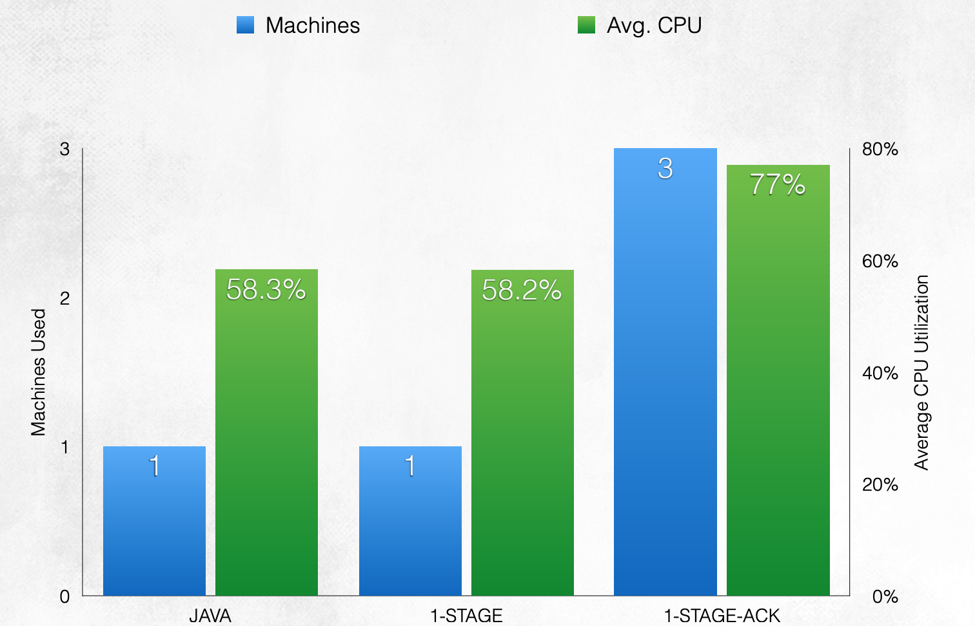
Storm overhead

Slide 59
Heron

Slide 60
References
https://www.tutorialspoint.com/apache_storm/index.htm
https://storm.apache.org/
https://www.youtube.com/watch?v=xWjxiZ36gSc
https://www.baeldung.com/apache-storm
https://blog.twitter.com/engineering/en_us/a/2015/flying-faster-with-twitter-heron.html

